Slide 1
1st Round Submission

Slide 2


Class Monitor Pitch Deck
Whatsapp Chatbot Pitch
Kitlong Wong 🤩
Yao Chen 😎
Shjie Huang 😄
Here is where your presentation begins
Yuxin Chen 😊
Xianrui He 🤓
Attend class in a SMART way 🤩🤓

Slide 3




Problem Statement
Introduction
Teacher 👩‍🏫
Teacher
1. Challenging to monitor individual student needs and provide personalized instruction and feedback.
2. Difficulty in selecting suitable and engaging personalized out-of-class materials for each student.
3. Hard to accurately measure and report comprehensive student learning progress and abilities.
Parent 👨‍👩‍👦
Student 👨‍🎓
Teacher
Teacher
1. Limited communication with parents regarding students' learning goals, achievements, and challenges.
2. Inadequate parental involvement and support in the learning process.
3. Absence of parental feedback on teacher satisfaction and class expectations.
1. Limited chances for students to ask questions or seek clarification during or after class.
2. Students' reluctance to participate in class activities due to fear of making mistakes or judgment.
3. Out-of-class supplementary materials that are dull or difficult.
Lack of regular and effective communication with parents about their children's learning goals, achievements, and challenges.
• Lack of parental involvement and support in their children's learning process and outcomes.
• Lack of feedback from parents on their satisfaction and expectations of the teacher and the class.
• Limited or no opportunities to ask questions or clarify doubts during or after class.
• Shy or reluctant to speak up or participate in class activities due to fear of making mistakes or being judged.
• Out-of-class supplementary materials are boring or too difficult.
Write your message

Slide 4
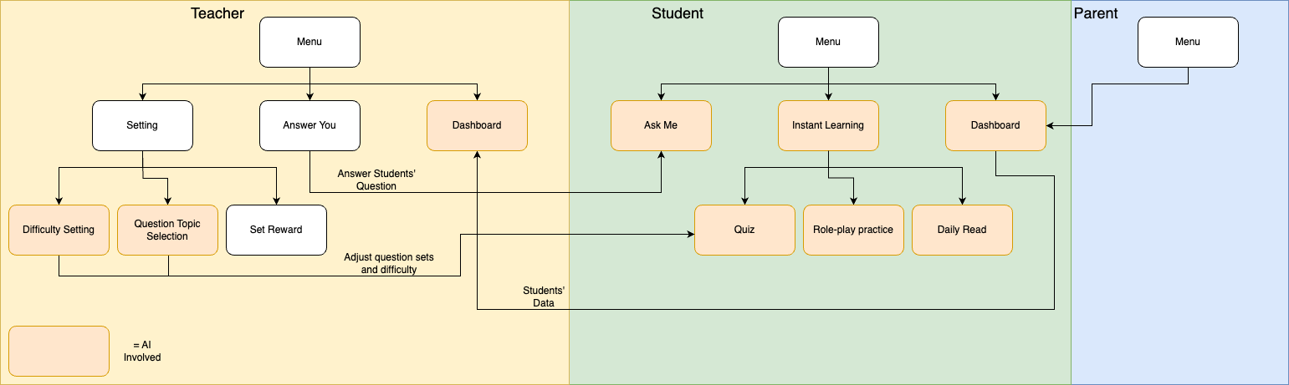
Product Overview
Ask Me 💬
An AI-powered Chatbot that answers students' questions. If the answer is not satisfied, it will be passed to the teacher for further assistance.
Clear Dashboard 📊
A transparent and comprehensive visualization of student learning progress.
Instant Learning 🎓
Provide personalize learning materials for language skills, system and culture.
3 account types with different functions:

Slide 5
Unique Selling Point
Flexible & User-friendly 😊
Based on WhatsApp for seamless accessibility and ease of use
Cost-effective solution for learning
Learn and teach anywhere, anytime
Achieve scalability with a highly adaptable Framework
AI-Powered Personalization 🤖💡
Customized difficulty and content based on students’ goal, interest and ability
AI-assisted quiz and question preparation
Crystal Clear Learning Progress 📈
Tracking improvement and Identifying strengths and weaknesses
Personalized advice from AI, teachers and parents

Slide 6
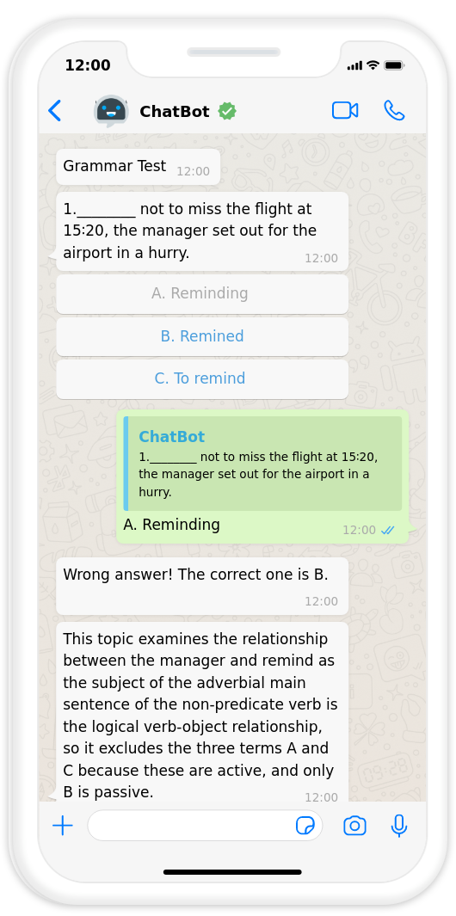
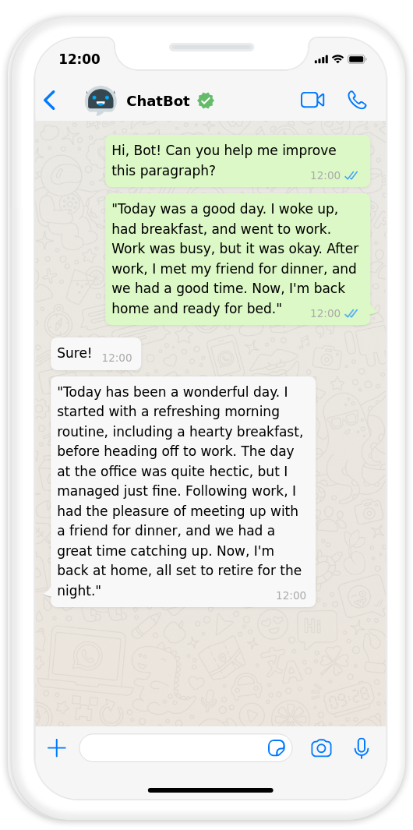
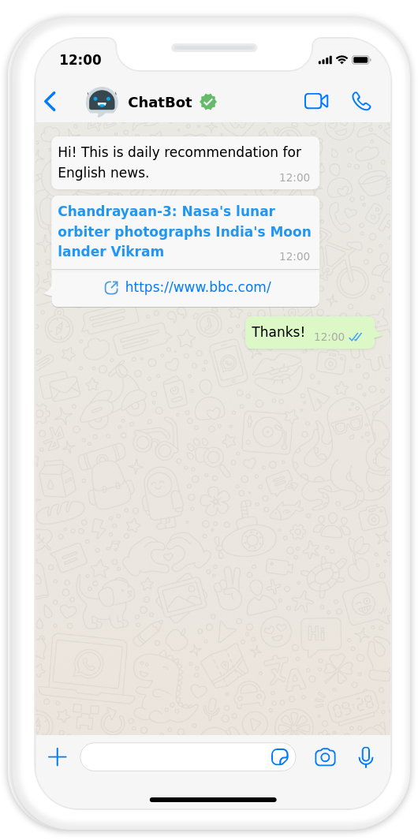
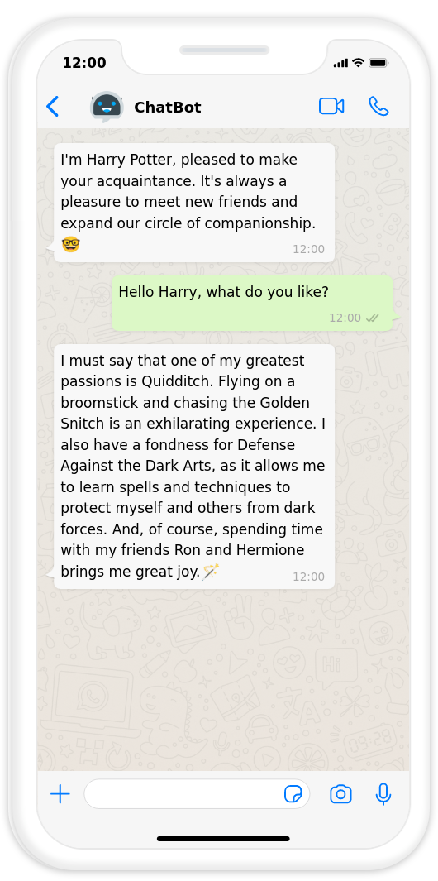
Feature 1: Instant Learning
Quiz 🧠
Quiz
Daily Read
Role Play 🎭
Writing Improve✍️
Daily Read 📖
Quiz
multiple-choice, fill-in-the-blank, matching, and word formation
Difficulty and content based on students’ past performace
Chatbot helps modify students’ writing, give advices and score
Personalized recommendations for Articles, News, and Videos
Short question to check students’ understanding
The Chatbot is designed to adopt various themes and engage in lively communication with students
Voice and text messaging

Slide 7


Feature 2: Ask Me
Quick Answer ✅
Answers
The chatbot responds to students' inquiries and provides them with accurate answers.
Efficient Management💼
Learning
Answers
Questions
The chatbot assists teachers in swiftly comprehending students' situations, eliminating the need for repetitive inquiries.
Unsolved Problems Summarization
AI Evolution 🤖
The chatbot learns from teachers' responses and incorporates that knowledge to offer improved solutions in future interactions.

Slide 8
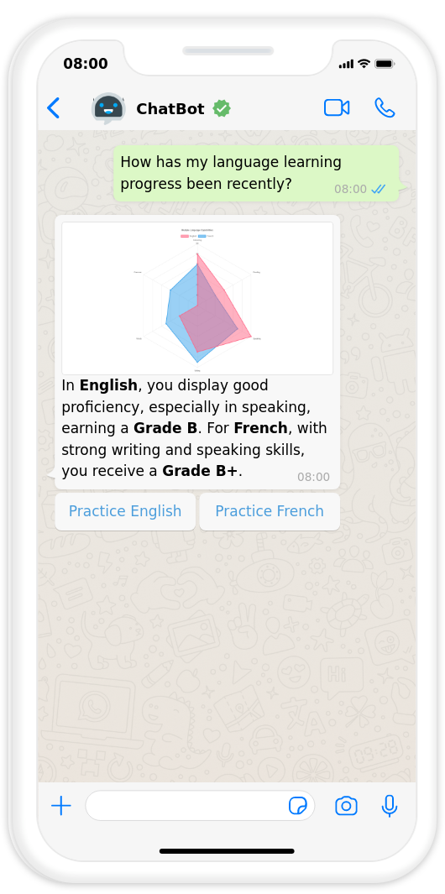
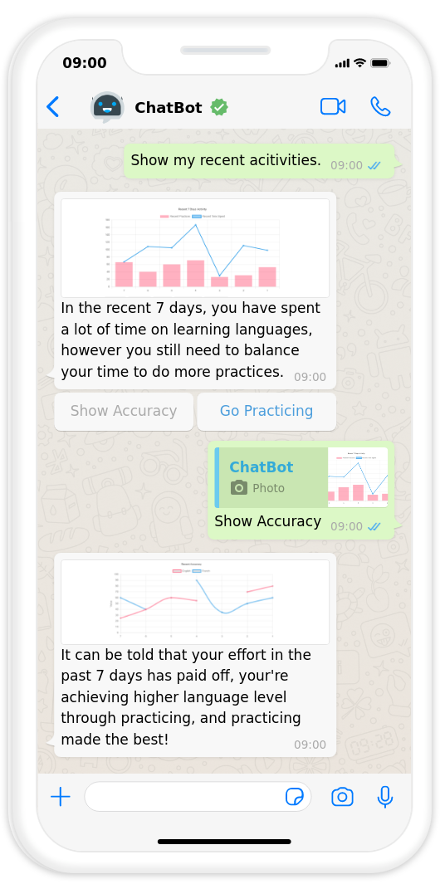
Feature 3: Students’ Dashboard
Performance Summary 📝
Detail Analysis 🔍
Quick review of students’ overall learning performance and activeness
A comprehensive review of various language skills and system
Insightful feedback and analysis generated by AI
Drill-down analysis: compare students’ performance over time, compare with classmates, progress towards personal goals, etc
Clear graphs are utilized to present the analysis and comparisons in a visually understandable manner.

Slide 9
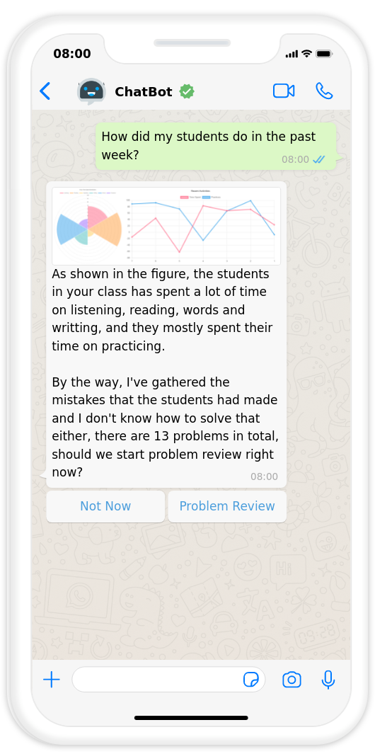
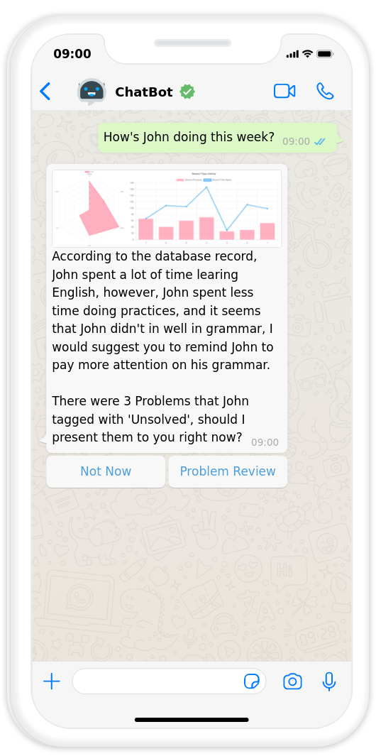
Feature 4: Teachers’ Dashboard
Class Summary 📊
Detail Analysis 💡
Quick review of class’ overall learning performance and activeness
A comprehensive review of various language skills and system
Students’ questions and parents’ feedback are analyzed and conslidated by AI
Drill-down analysis of a specific student
Clear graphs are utilized to present the analysis and comparisons in a visually understandable manner.

Slide 10
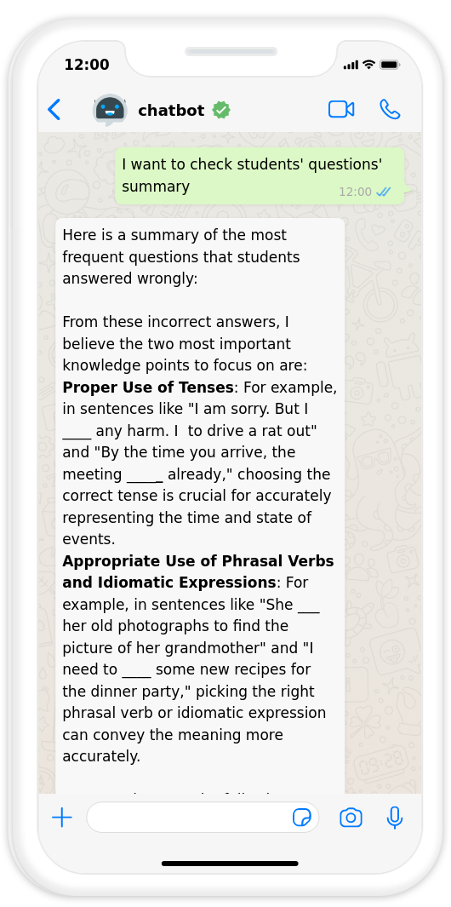
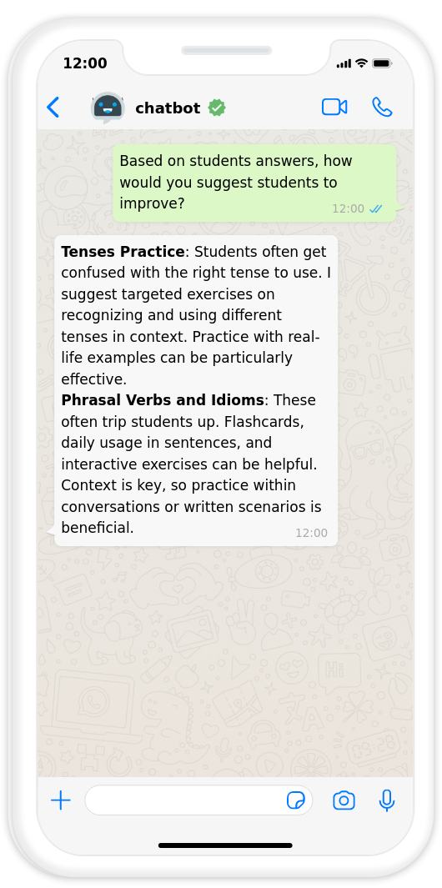
Feature 5: Smart Customization
Customized Reply 📩
Content Adjustment📚
Teachers have the capability to respond to questions and feedback from both students and parents
The AI system learns from the comments and responses provided by teachers, enabling it to improve its future responses based on the acquired knowledge
Teachers have the ability to modify the difficulty level and learning content for the entire class or individual students
The AI provides helpful suggestions to assist teachers in making appropriate adjustments based on their inputs and requirements.

Slide 11
Tech Stack & Advantages
01
02
Intelligent Assistant
Evolutionary Assistant
AI-powered assessments, dynamic quiz generation, and common query summarization
Harnessing the ower of vector store for self-optimizing intelligence and adaptive learning. Never repeating the same mistake.
03
04
Multi-Scenario Knowledge Base
Personalized Study Material
using vector store to achieve intelligent function dispatch and ensuring accuracy on relevant topics while avoiding off-topic/sensitive content
using reinforcement learning & recommandation system to tailoring learning resources to Individual needs & abilities

Slide 12
2nd Round Submission

Slide 13
Class Monitor Pitch Deck
Whatsapp Chatbot Pitch
Kitlong Wong 🤩
Yao Chen 😎
Shjie Huang 😄
Here is where your presentation begins
Yuxin Chen 😊
Xianrui He 🤓
Attend class in a SMART way 🤩🤓

Slide 14
Class Monitor
Background
01

Slide 15
Problem Statement
Introduction
Teacher 👩‍🏫
Teacher
1. Challenging to monitor individual student needs and provide personalized instruction and feedback.
2. Difficulty in selecting suitable and engaging personalized out-of-class materials for each student.
3. Hard to accurately measure and report comprehensive student learning progress and abilities.
Parent 👨‍👩‍👦
Student 👨‍🎓
Teacher
Teacher
1. Limited communication with parents regarding students' learning goals, achievements, and challenges.
2. Inadequate parental involvement and support in the learning process.
3. Absence of parental feedback on teacher satisfaction and class expectations.
1. Limited chances for students to ask questions or seek clarification during or after class.
2. Students' reluctance to participate in class activities due to fear of making mistakes or judgment.
3. Out-of-class supplementary materials that are dull or difficult.
Lack of regular and effective communication with parents about their children's learning goals, achievements, and challenges.
• Lack of parental involvement and support in their children's learning process and outcomes.
• Lack of feedback from parents on their satisfaction and expectations of the teacher and the class.
• Limited or no opportunities to ask questions or clarify doubts during or after class.
• Shy or reluctant to speak up or participate in class activities due to fear of making mistakes or being judged.
• Out-of-class supplementary materials are boring or too difficult.
Write your message

Slide 16
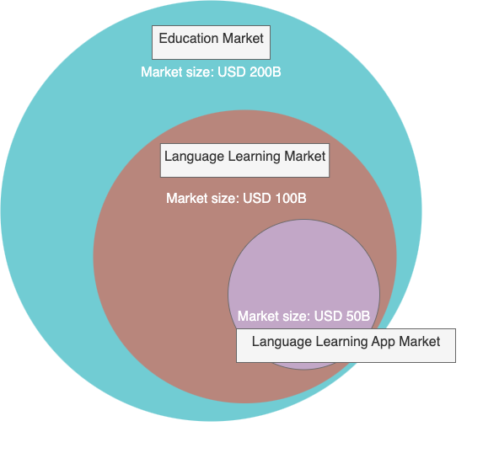
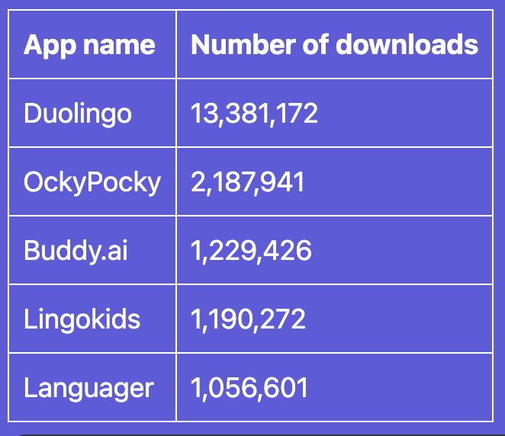
Market Opportunity
The educational market, Language Learning market is massive.

Slide 17
Unique Selling Point
Our product is a WhatsApp chatbot for language learning that leverages the power of large language models (LLMs) to provide a personalized and interactive learning experience. Unlike other platforms, our product offers:
Comprehensive Learning Approach ✅
covers all aspects of language skills, such as writing, listening, speaking, and Q&A.
Flexible & User-friendly 😊
Based on WhatsApp for seamless accessibility and ease of use
Cost-effective solution for learning
Learn and teach anywhere, anytime
A comfortable and engaging learning environment that simulates real-life conversations and scenarios, making language learning more fun and natural.
AI-Powered Personalization 🤖💡
Data driven & customized difficulty and content based on students’ goal, interest and ability
AI-assisted quiz and question preparation
Cutting edge techniques to ensure the stability and accuracy of chatbot
Crystal Clear Learning Progress 📈
A supportive and collaborative system that empowers teachers, students, and parents with clear and timely feedback, insights, and guidance
Personalized advice from AI, teachers and parents

Slide 18
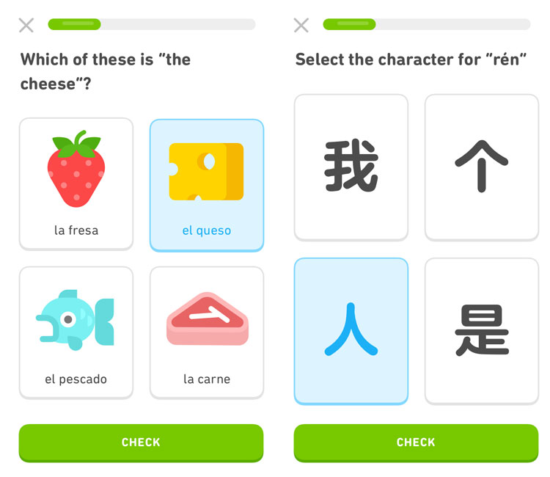
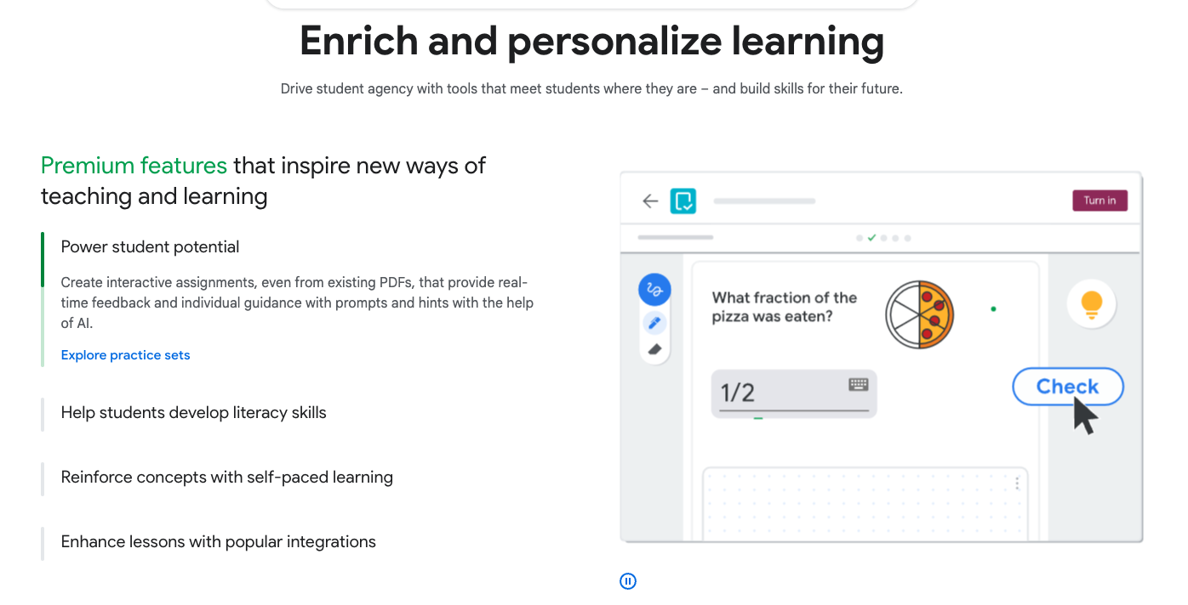
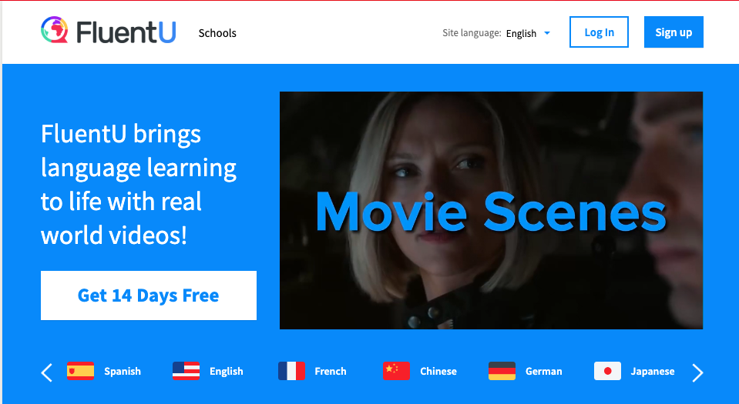
Competitor Analysis
Website |  | https://www.duolingo.com/ | https://www.fluentu.com/ | https://edu.google.com/intl/ALL_us/workspace-for-education/classroom/
Aspect |  | Duolingo | FluentU | Google for Education | Class Monitor
Student Perspective | Learning Experience & Content Variety | Fun but limited content, mainly quizzes | Video-focused with limited exercises | Highly dependent on teacher's material design | Comprehensive, including quizzes, role-play, and daily readings
Teacher Perspective | Flexibility & Material Preparation | Limited flexibility | Limited flexibility | Too high flexibility | Moderate flexibility and low workload with AI support

Slide 19
Class Monitor
Estimated Daily Messages: 3 million.
Assumption: Average Messages per Student: 20 messages with the chatbot each day, based on typical WhatsApp user behavior.
Number of Student: Nearly 1.5 billion people globally are learning a second language. Assume we reach 0.01% of them, then the number of student is 0.15M.

Slide 20
Product Overview
Ask Me 💬
An AI-powered Chatbot that answers students' questions. If the answer is not satisfied, it will be passed to the teacher for further assistance.
Clear Dashboard 📊
A transparent and comprehensive visualization of student learning progress.
Instant Learning 🎓
Provide personalize & fun learning materials for language skills, system and culture.
3 Account Types 🧾
Parent: view students’ performance
Student: work on the exercise
Teacher: monitor students’ performance and manage the class

Slide 21
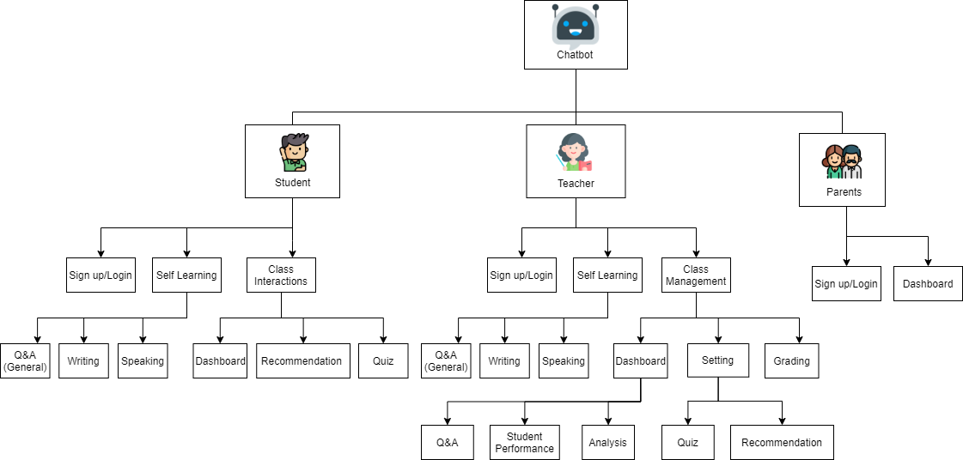
Product Overview
Student
Self-learning
Class Interactions
Teacher
Self-learning
Class Management
Parents
Monitor

Slide 22
Class Monitor
Product Description
02

Slide 23
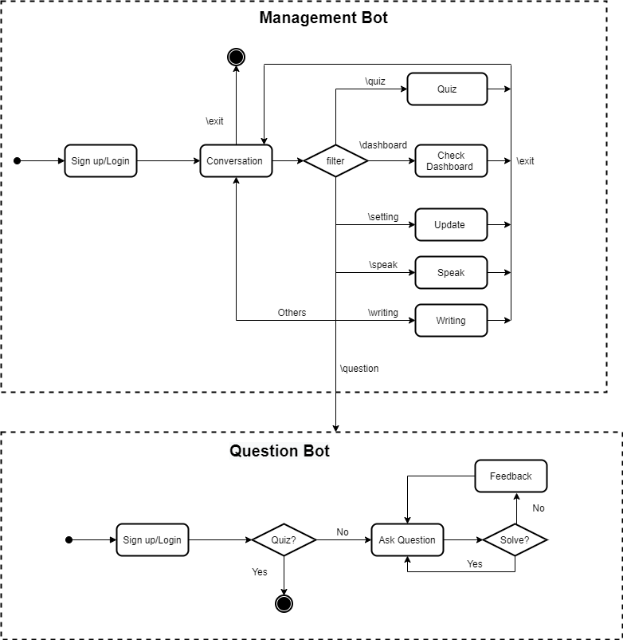
State Diagram
Two Bots for Efficient Learning
During the conversation, each sentence from a user is a command for chatbot. So, for simplicity, we design two bots for language learning.
Management Bot: Aim for general user cases. Students can use the bot for self-learning and check their performances. Teachers can also enrich their language knowledge and analyse the overall records.
Question Bot: deal with students’ problems and report to a teacher if the problem hasn’t been solved. It will be deactivated when students take quiz.
Note: We apply a LLM filter that supports the natural language to match correct statements not just using hardencoding commands.

Slide 24
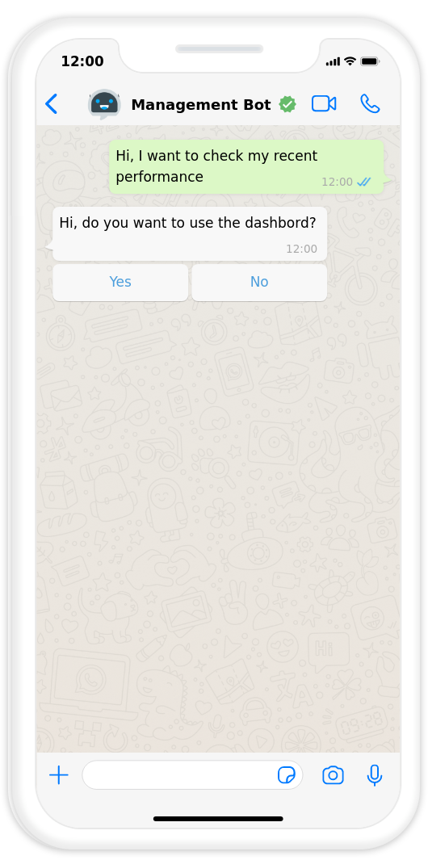
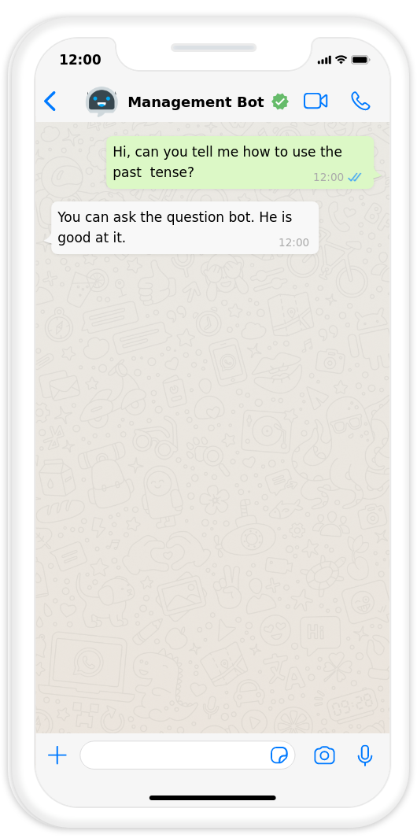
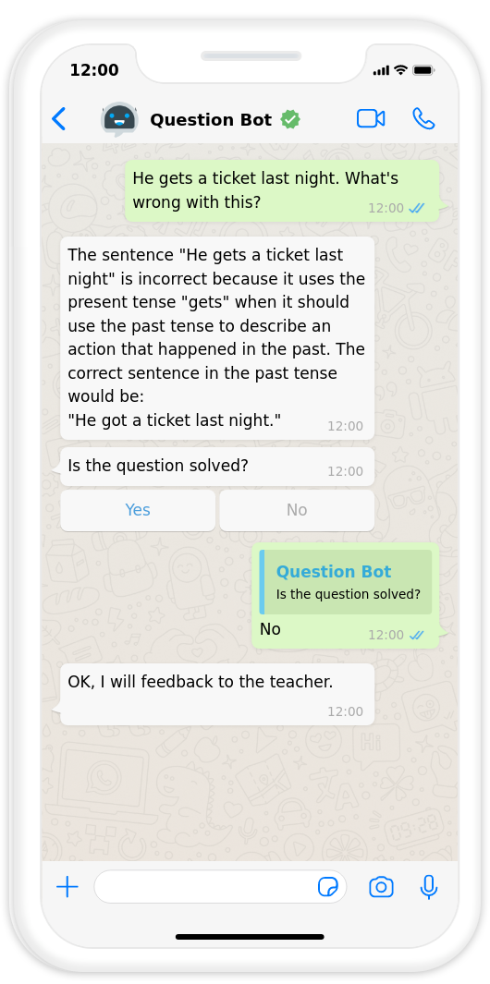
State Diagram UI
Management Bot
Question Bot
Management bot handles general learning user cases while question bot deals with student problems.

Slide 25
Feature 1: Instant Learning
Quiz 🧠
Quiz
Daily Read
Role Play 🎭
Writing Improve✍️
Daily Read 📖
Quiz
multiple-choice, fill-in-the-blank, matching, and word formation
Difficulty and content based on students’ past performace
Chatbot helps modify students’ writing, give advices and score
Personalized recommendations for Articles, News, and Videos
Short question to check students’ understanding
The Chatbot is designed to adopt various themes and engage in lively communication with students
Voice and text messaging

Slide 26
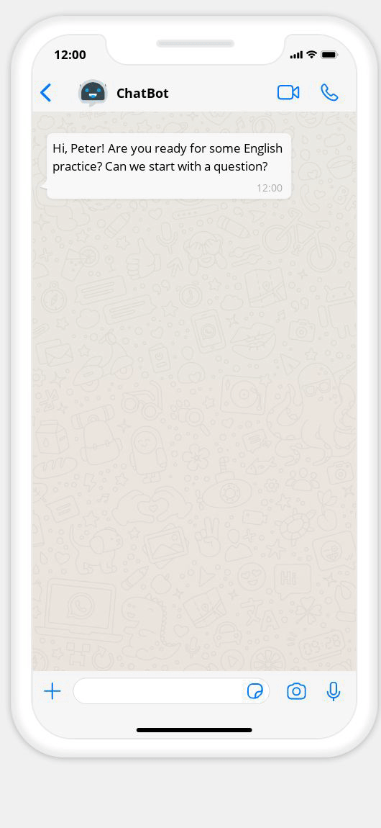
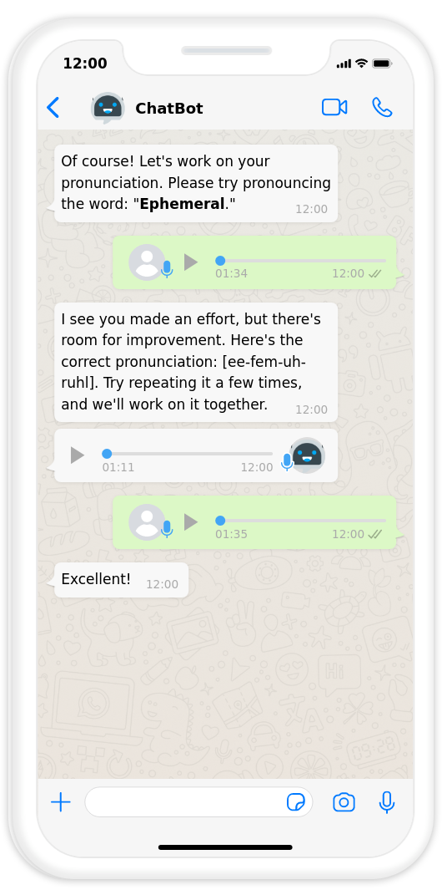
Instant Learning: Quiz
The questions types include:
Multiple Choice Questions (MCQs)
Fill in the Blanks
Matching Questions
True or False
Listening Comprehension
Sentence Rearrangement
Vocabulary Matching
Translation
Grammar Questions
Reading Comprehension
It operates through a real-time response loop, taking into account students' past performance and adjusting question difficulty accordingly.
Speech Recognition API is used to evaluate student’s pronunciation.

Slide 27
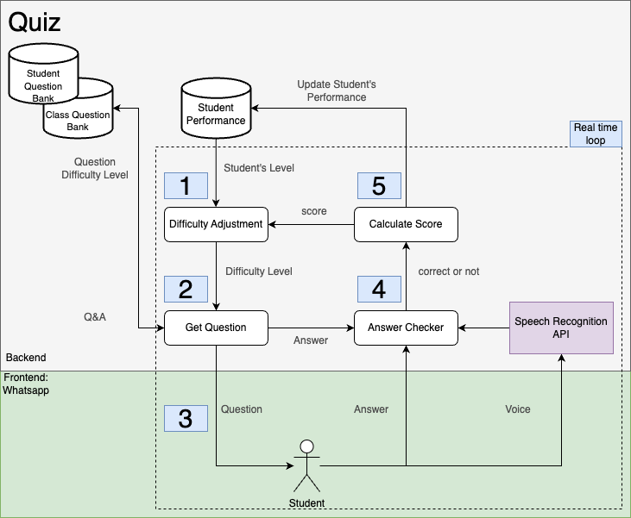
Instant Learning: Quiz
1. Difficulty Adjustment:
Based on the student's past performance, the system determines an appropriate difficulty level for the quiz.
2. Question Selection:
The system inputs the difficulty level into the "GetQuestion" function.It retrieves questions from the student question bank tailored to the determined difficulty level.
3. Question Delivery:
The chatbot sends a question to the student.
4. Student Response and Tracking:
The student answers the question, and the chatbot tracks their response. For speaking questions, speech recognition technology is used to assess pronunciation and accuracy.
5. Real-Time Scoring:
The system calculates the student's score immediately after they provide an answer. The score is influenced by factors such as response time and accuracy.
6. Dynamic Difficulty Adjustment:
Based on the student's performance on the current question, the system adjusts the difficulty level for the next question. If a student struggles, the next question may be less difficult to provide a supportive learning experience.

Slide 28
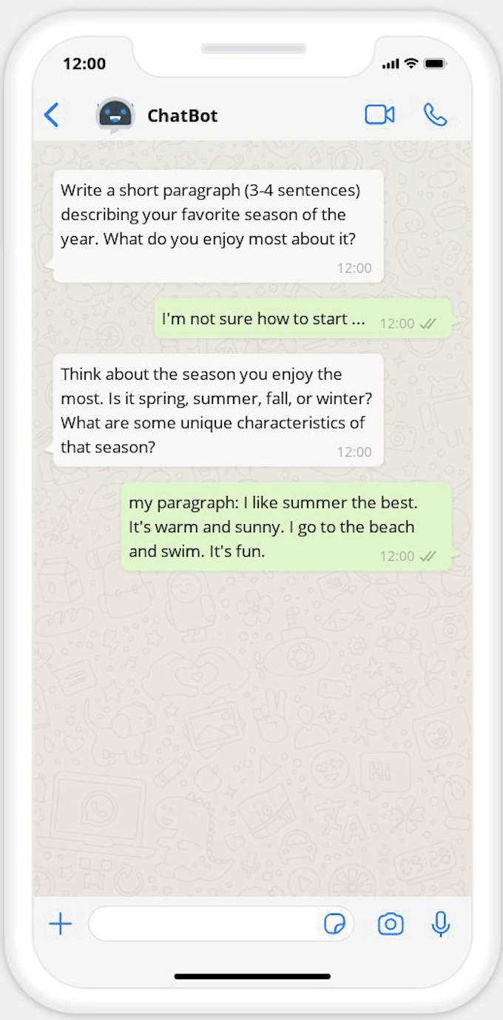
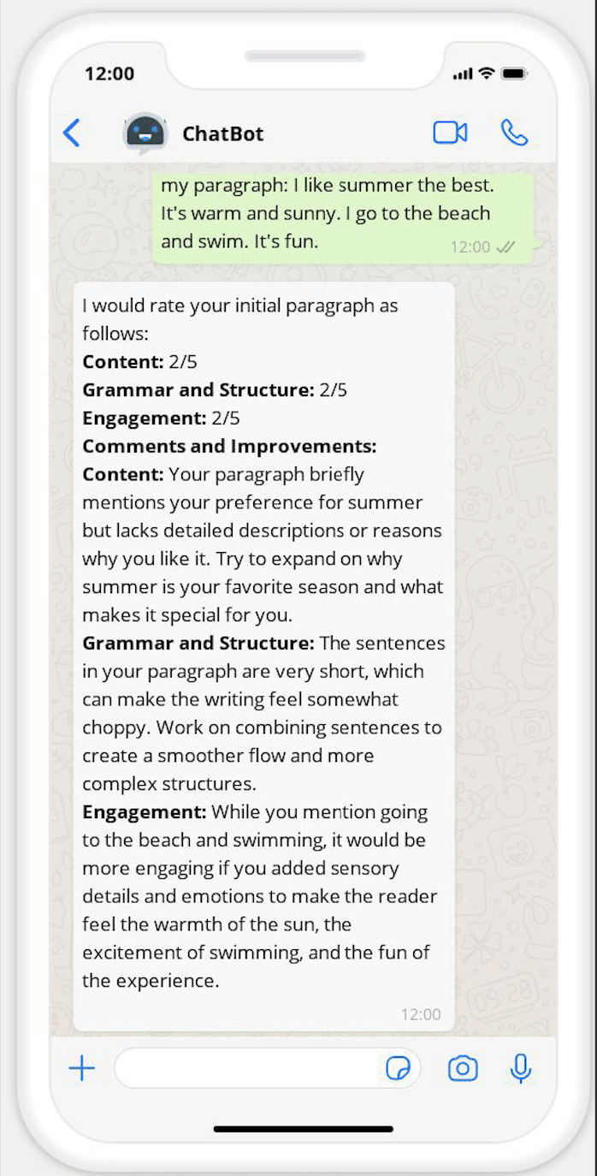
Instant Learning: Writing
This module provides tailored writing practice and constructive feedback, facilitating students' progressive improvement in their writing skills.
The writing task are usually a short paragraph. As it is inconvenient to type long passage in phone.

Slide 29
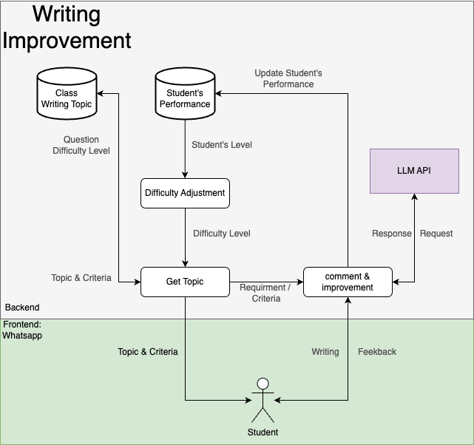
Instant Learning: Writing
Adaptive Difficulty:
The system evaluates the student's historical performance to ascertain their proficiency in writing and dynamically adjusts assignment difficulty levels accordingly.
Topic Presentation:
Following the assessment of the student's skill level, the system introduces an appropriate writing topic.
Student Submissions:
Students are tasked with composing and submitting their written work based on the assigned topic.
AI Feedback:
Leveraging a Large Language Model API, the system provides comprehensive feedback on students' submissions, offering valuable suggestions for enhancement.
Performance Tracking:
A meticulous record of students' writing submissions and feedback is meticulously maintained within their performance profiles. This allows for continuous monitoring of progress.

Slide 30
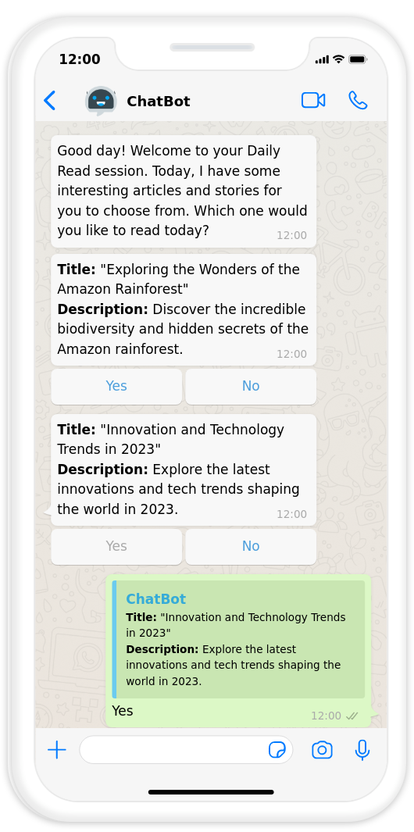
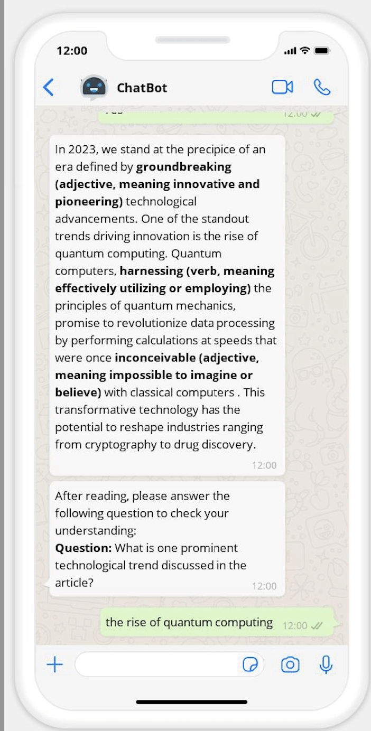
Instant Learning: Daily Read
This module encourages daily reading and comprehension practice while providing students with content that aligns with their interests and skill levels.
Benefit:
Vocabulary Expansion: Exposure to diverse vocabulary enhances language skills.
Improved Comprehension: Regular reading improves understanding of written content.
Enhanced Fluency: Reading helps with natural language flow and rhythm.
Cultural Insight: Literature provides cultural context and insights.
Better Writing: Exposure to well-written content aids in writing skills.

Slide 31
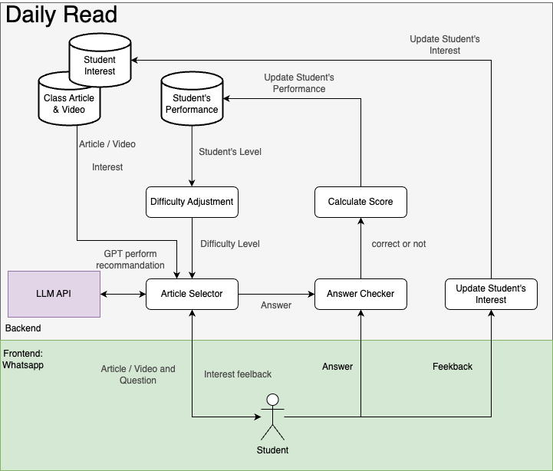
Instant Learning: Daily Read
Adaptive Content Selection:
The system examines students' past performance records to gauge their reading proficiency and interests.
Content Recommendation:
Utilizing data from class articles, videos table, and student interest tables, the system employs a recommendation algorithm, possibly utilizing LLM, to propose pertinent articles or videos.
Content Delivery:
The chosen content is presented to the student, typically with a selection of five options. Students can opt for the one they prefer to read or view.
Comprehension Assessment:
After reading, students are required to answer questions to evaluate their comprehension of the content.
Scoring and Performance Tracking:
The system computes a score based on the student's responses and stores it in their performance profile for ongoing progress monitoring.

Slide 32
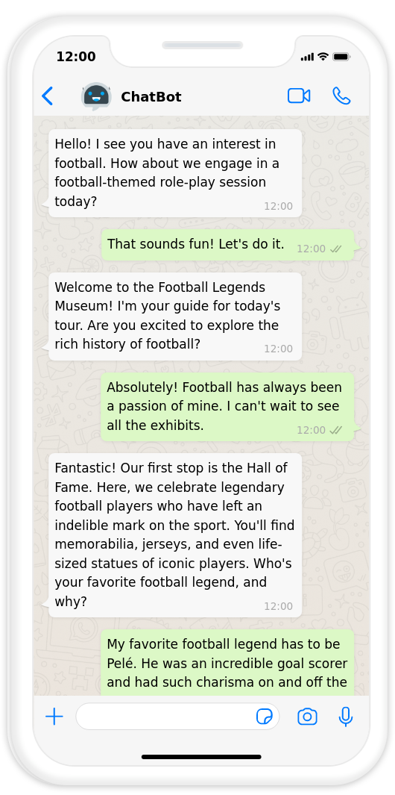
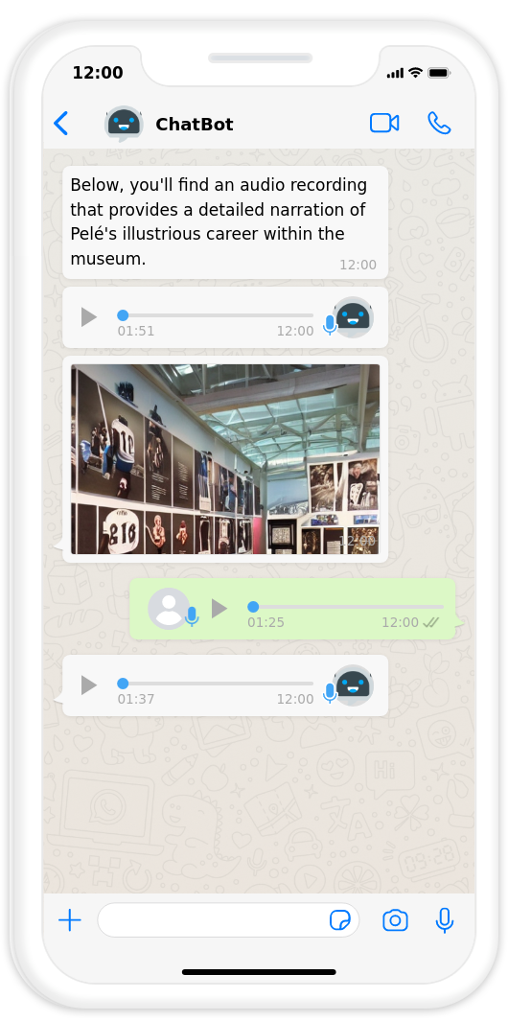
Instant Learning: Role-Play
Benefit of role-play:
Students assume specific roles in scenarios.
Practice English: Engage in conversations, decision-making, and problem-solving.
Develop skills: Improve speaking, listening, and critical thinking.
Gain confidence: Use English in practical situations.
Versatile: Suitable for various scenarios like job interviews and everyday conversations.
Interesting & interactive: Enhances engagement and enjoyment in learning. Especially when targeting students’ interest.

Slide 33
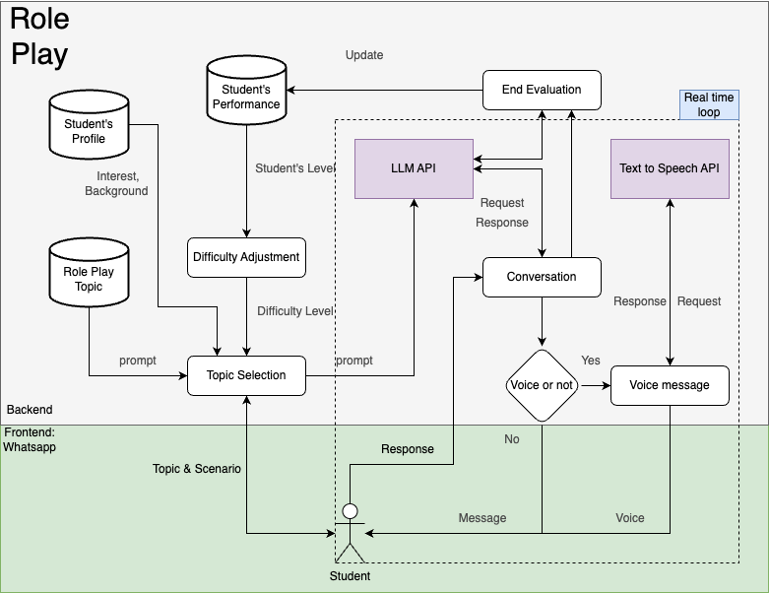
Instant Learning: Role-Play
Adaptive Difficulty: The system assesses the student's past performance records to determine their language proficiency level, allowing for tailored difficulty adjustments.
Topic Selection: Based on the student's profile background, the system selects a suitable conversation topic.
Topic Presentation: The chosen topic is presented to the student, who can decide whether to continue with it or select a new one.
Conversation Initiation: If the student confirms the chosen topic, the conversation begins. There are two modes: text-based and voice-based.
Voice-Based Interaction: In voice mode, the system utilizes text-to-speech and voice recognition APIs to facilitate interactive voice conversations, making it a more immersive experience.
Continuous Interaction: The conversation continues until both parties feel it is complete.
AI Evaluation: Upon completion, the system employs GPT to evaluate the quality of the student's responses and provides constructive feedback.

Slide 34
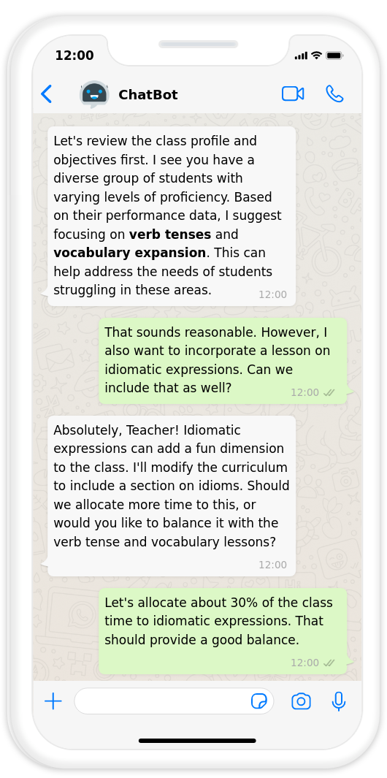
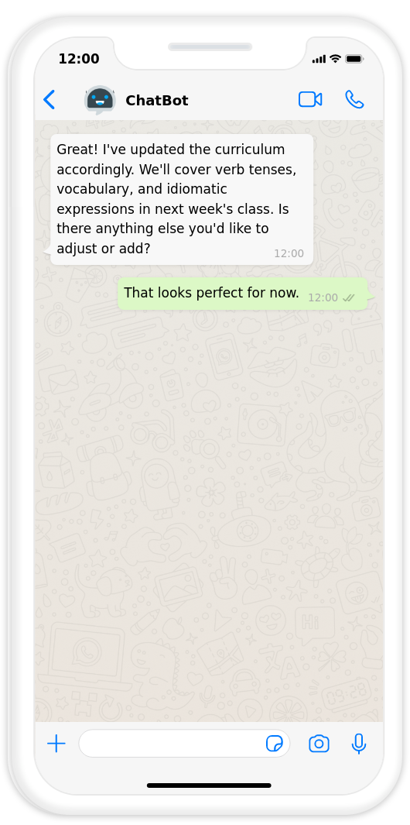
Feature 2: Smart Customization
Teachers have the ability to modify the difficulty level and learning content for the entire class or individual students
The AI provides helpful suggestions to assist teachers in making appropriate adjustments based on their inputs and requirements.

Slide 35
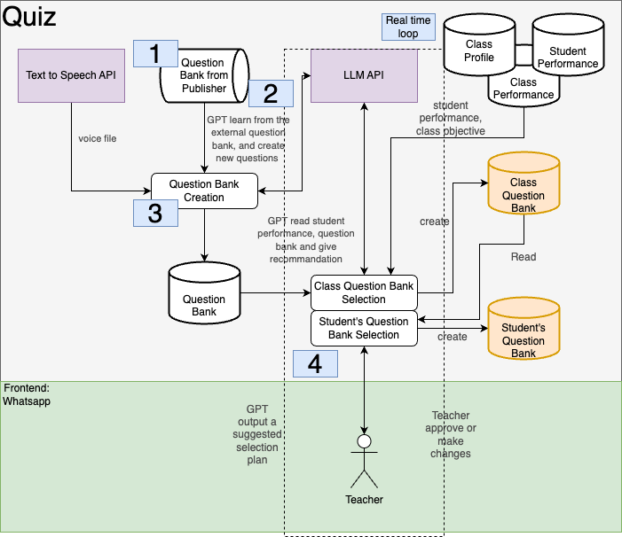
Smart Customization: Content Adjustment
Data Management Process for Instant Learning Features:
Question Bank: Initial questions sourced from publishers and online materials. LLM expands the database by creating questions.
Teacher Interaction: Teachers engage in question bank selection. LLM analyzes data to understand student goals.
Curriculum Suggestions: LLM offers advice based on student performance, e.g., recommending more past tense-related questions when LLM sees students not do well.
Customization: Teachers tailor question selection, adjusting question proportions to suit classroom needs.
Question Creation: LLM retrieves questions based on teacher's choices, creating both class and personalized student question banks.
Class vs. Student Banks: Class bank for most students; student bank highly customized, addressing individual or subgroup learning requirements.

Slide 36
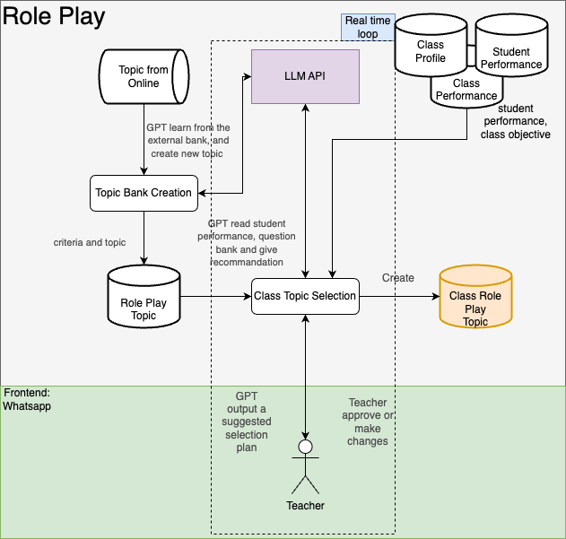
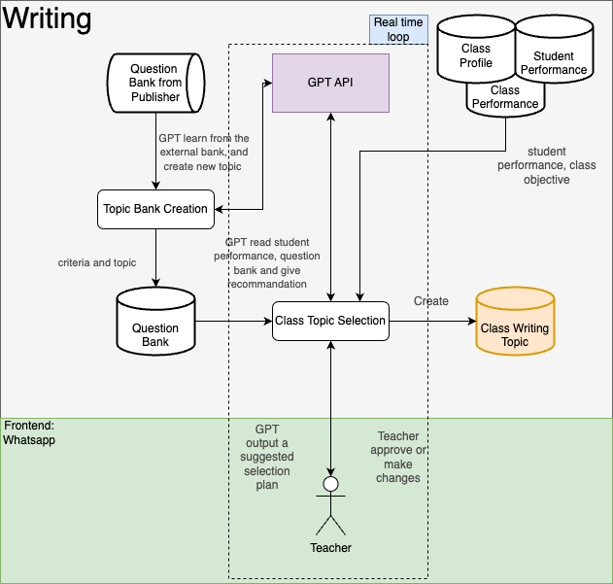
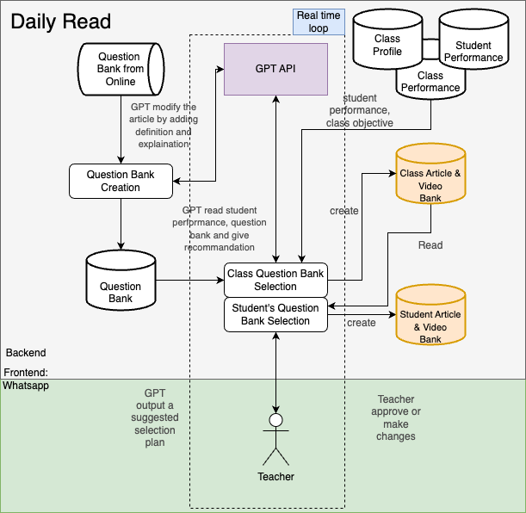
Smart Customization: Content Adjustment
Similar structure with quiz table.

Slide 37
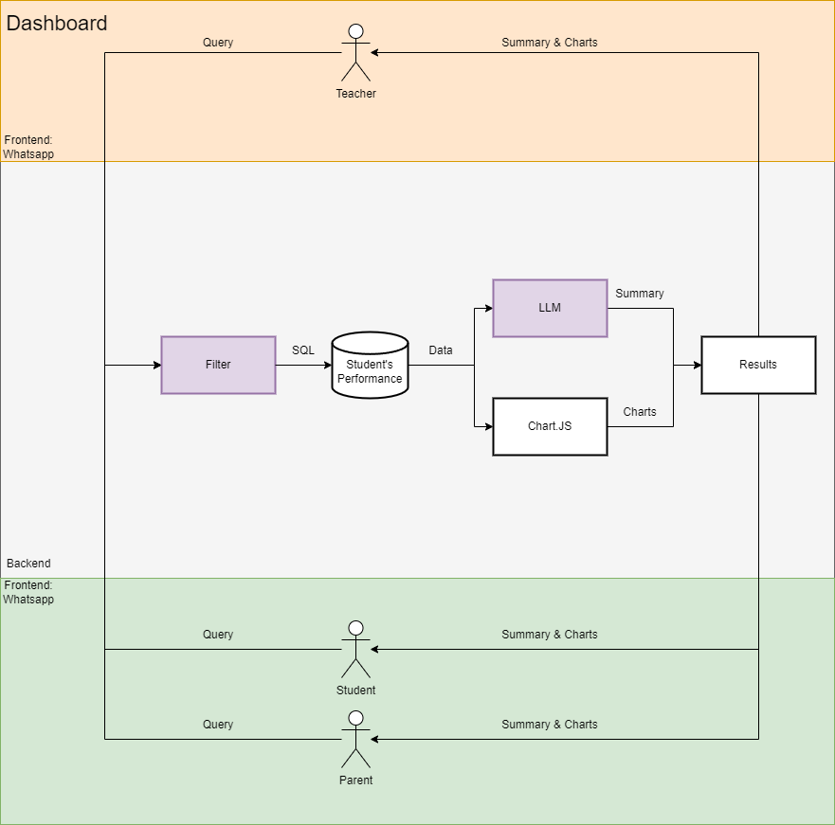
Feature 3: Dashboard
The dashboard provides tailored insights for Students, Parents, and Teachers, enabling them to make informed academic decisions:
1. User Access:
Students: View personal academic metrics.
Parents: Monitor their child's academic growth.
Teachers: Overview the performance of their entire class.
2. Data Retrieval:
Instantly fetches and processes user-specific academic data for accurate insights.
3. Summaries via GPT API:
Leverages GPT API for crisp, meaningful performance summaries.
4. Visualization with Chart.JS:
Transforms data into intuitive charts for quick insights.
5. Platform Integration:
Accessible via the familiar WhatsApp platform for ease of use.
6. Dynamic Difficulty Adjustment:
By streamlining data and visual insights, the Dashboard empowers users to optimize their academic experiences.

Slide 38
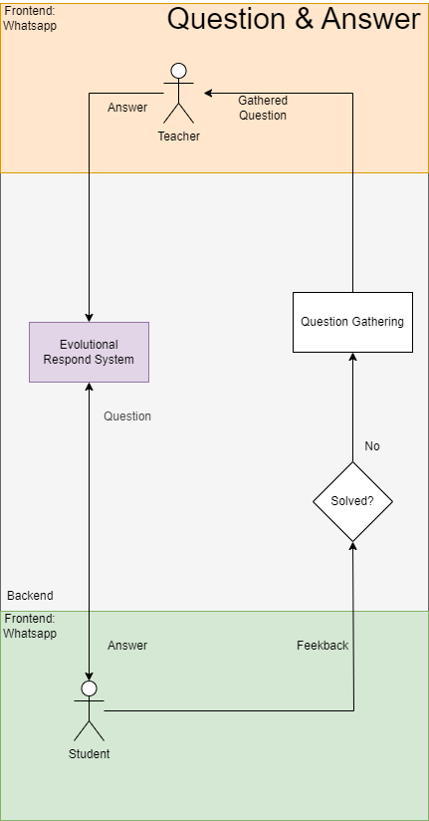
Feature 4: Question & Answer
1. Evolutionary Response System:
At the heart of the interaction lies the sophisticated respond system. It's equipped with AI capabilities, aiming to provide the most accurate answers based on the input it receives.
Question Gathering: Whenever a student poses a query, the system initially attempts to provide an immediate answer, drawing from its vast database of predefined responses and dynamic AI algorithms.
2. Feedback and Refinement:
The system values the student's feedback. If a student isn't satisfied with the initial response, the query undergoes further scrutiny. This feedback loop ensures continuous improvement in the system's answering capabilities.
3. Human Oversight with Teacher's Intervention:
Recognizing the limits of machine learning, the system seamlessly escalates unresolved queries to a human teacher. This blend of AI and human insight ensures that students receive comprehensive answers, bridging the gap between automated and human-led education.
4. Integrated Experience:
The entire interaction is streamlined through Whatsapp, providing students with a familiar and user-friendly platform. This integration ensures that students can focus on learning without navigating a new digital landscape.

Slide 39
Class Monitor
Technological Specifications
03

Slide 40
Tech Stack
API / Model | Description | Features that use the API
openai/whisper-base | Speech Recognition | Role-play, Quiz, Q&A
microsoft/speecht5_tts | Text to Speech | Role-play, Quiz, Q&A
Pollinations.ai | Image GPT | Role-play, Quiz, Quiz Question Bank
Chart.js | Json to Chart | Dashboard
ChatGPT 3.5 | LLM for performing simple interaction | Menu and All Features
ChatGPT 4.0 | LLM for Q&A evaluation and question generation | Q&A, Quiz Question Bank
Cohere Extracter | SQL Parameter Detector | Dashboard

Slide 41
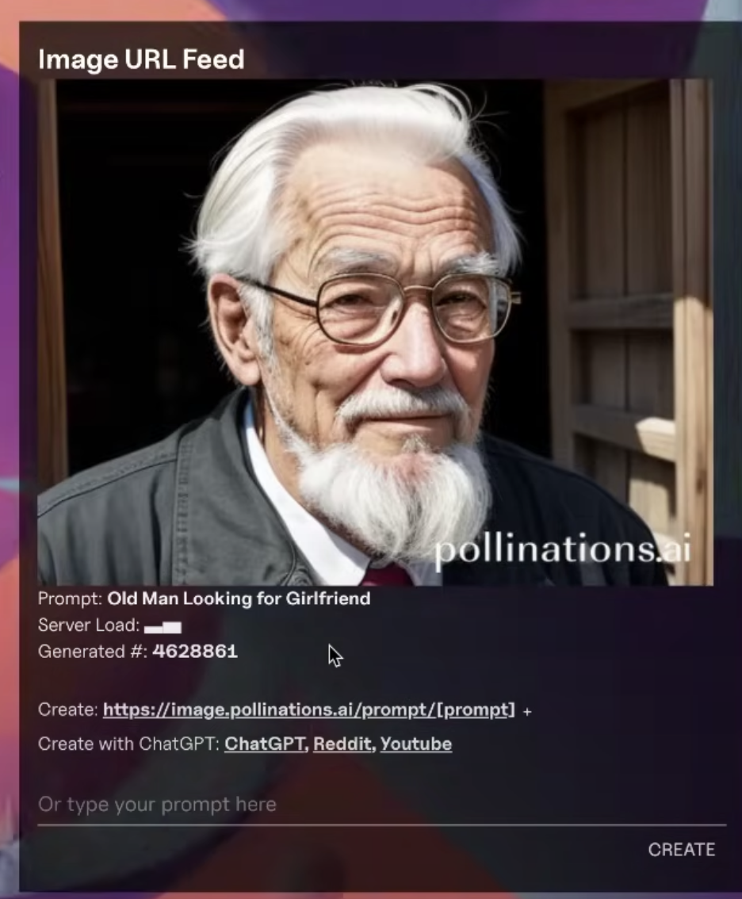
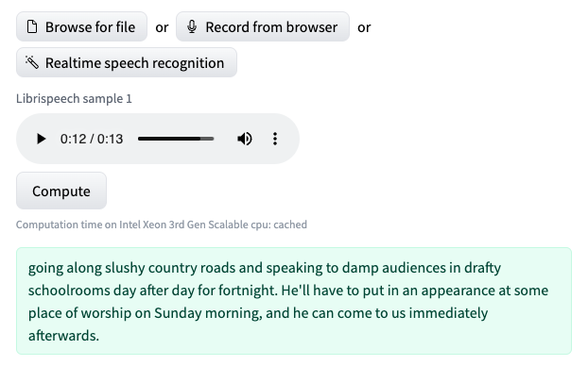
Multimedia Learning Experience
This is applied in Role-play, Writing, Quiz and Question bank generation.
Speech Recognition & Text to Speech API:
These APIs are pre-trained and allow for seamless conversion of text to voice files and vice versa.
Our chatbot will interact with these APIs by sending and receiving text data
openai/whisper-base & microsoft/speecht5_tts are fast, simple and stable
Image GPT:
Our chatbot will generate a prompt for generating image and send it to image GPT.
Pollinations.ai has their own user-friendly API

Slide 42
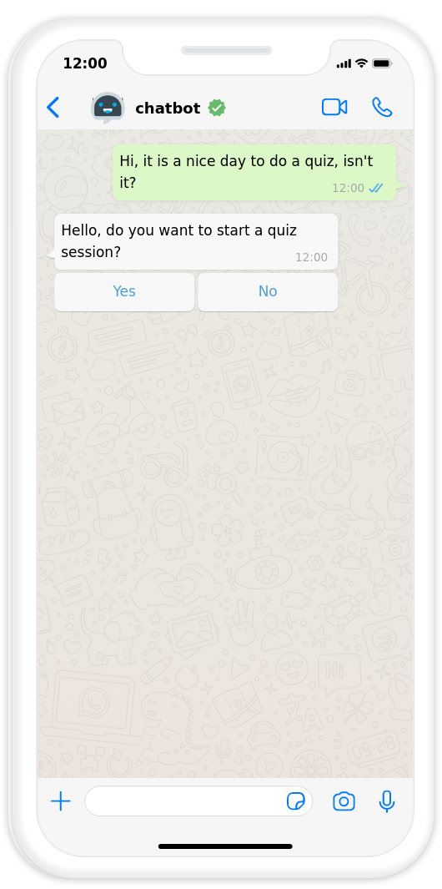
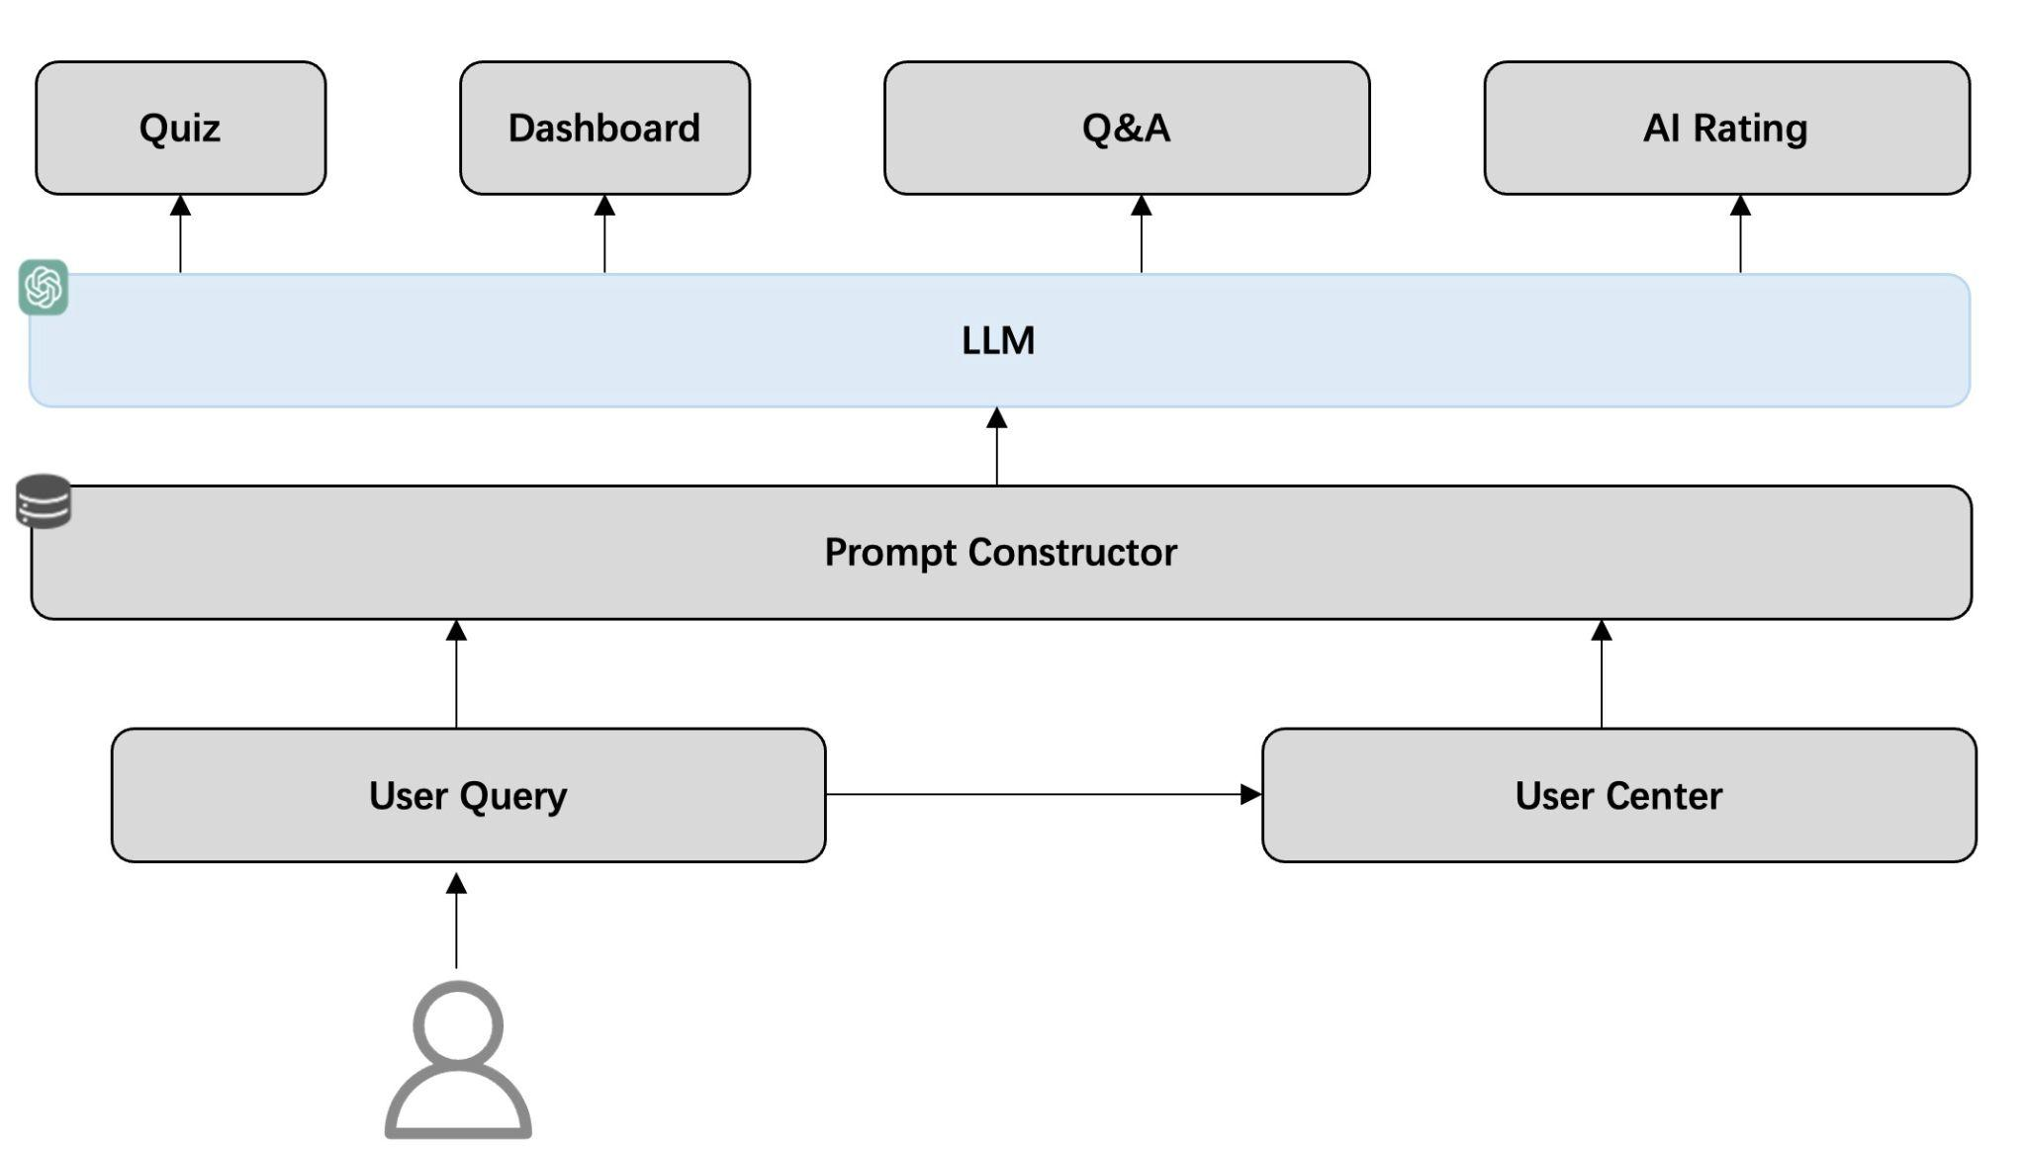
Menu: Mapping Natural Language to Functions
This is applied in Menu.
Guiding user to different functions.
LLM-based Intelligent Distributor: Map a natural language expression to a navigation function call through prompt engineering techniques. Make decision based on user query and information from user center.
Notes:
dsadsadsafas

Slide 43
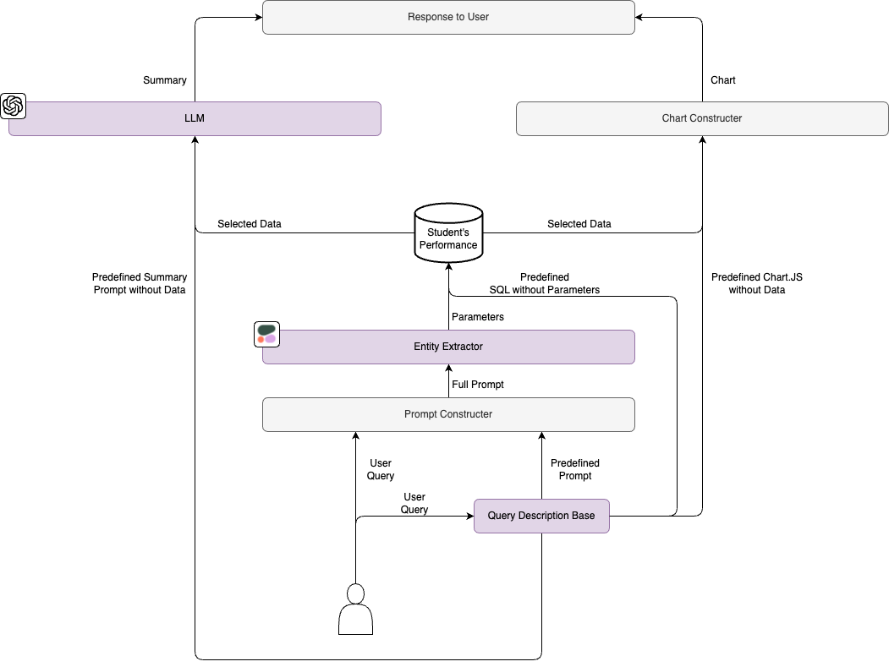
Dashboard: Generate SQL
The central intelligence of this Filter method lies with the LLM, adeptly decoding user queries and coordinating with the suite of functional modules to produce the charts and summaries.
Upon receiving a user query, the Entity Extractor swiftly identifies salient data points, harnessing reference templates from the SQL Prompt Base. This dynamic base, armed with a spectrum of SQL templates and visualization blueprints, serves as the foundational bedrock, enabling other components to derive structured, actionable insights.
Then, the Prompt Constructor steps in, sculpting precise data requests by weaving inputs from the Entity Extractor with SQL blueprints. Its adeptness ensures that the most pertinent data slices are always at the forefront.
Concluding the user experience, the Chart Constructor translates the curated data into compelling visual narratives. It draws its design cues from a set of predefined chart templates in the SQL Prompt Base, ensuring that insights are not only accurate but also visually engaging.

Slide 44
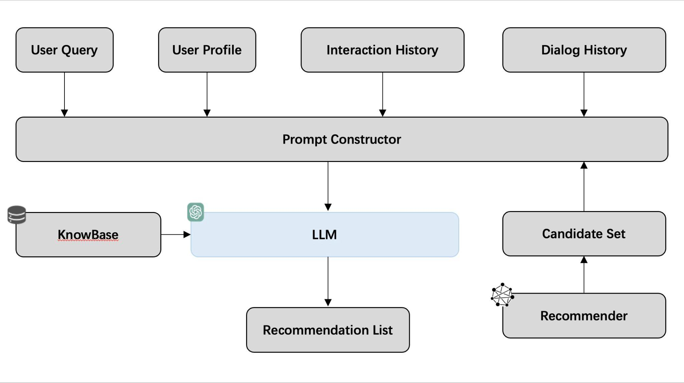
Daily Read: Recommendation System
LLM-enhanced Recommendation System is applied on Daily Read function.
Concatenate the user query, user profile, interaction history, dialog history and candidate set to construct a prompt, asking LLM to generate the recommendation list.
Apply KnowBase(Vector Store like Faiss) to handle cold-start problems, for example, some information after 2022 is unrecognised by LLM. So if a user asks about a recent event, we can utilize KnowBase to handle recommendation tasks.
Candidate set is generated by deep-learning based recommender, which can be updated with the increase of user data.
[2303.14524] Chat-REC: Towards Interactive and Explainable LLMs-Augmented Recommender System (arxiv.org)

Slide 45
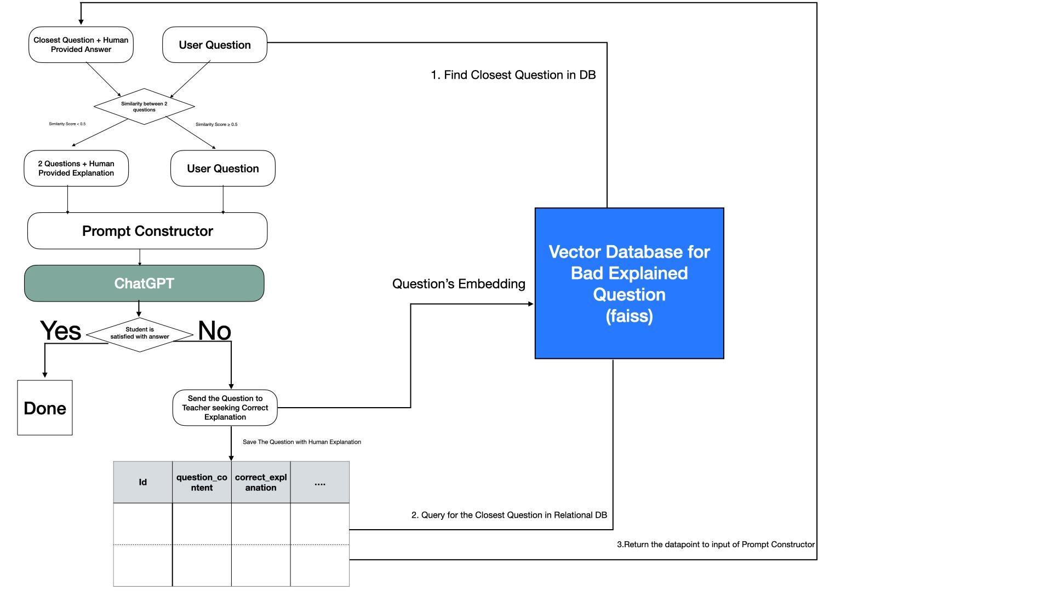
Q&A: Evolutionary AI
This is applied in Q&A.
.
Using well-designed Prompt Constructor and Vector Database to give LLM premise or correct explanation of a question.
Then AI has an ability to learn from previous similar mistake, which makes LLM can answer the question better.
As time goes on, the vector database getting more completed, the AI can answer the question better by considering more previous explanation.

Slide 46
Class Monitor
Scalability
04

Slide 47
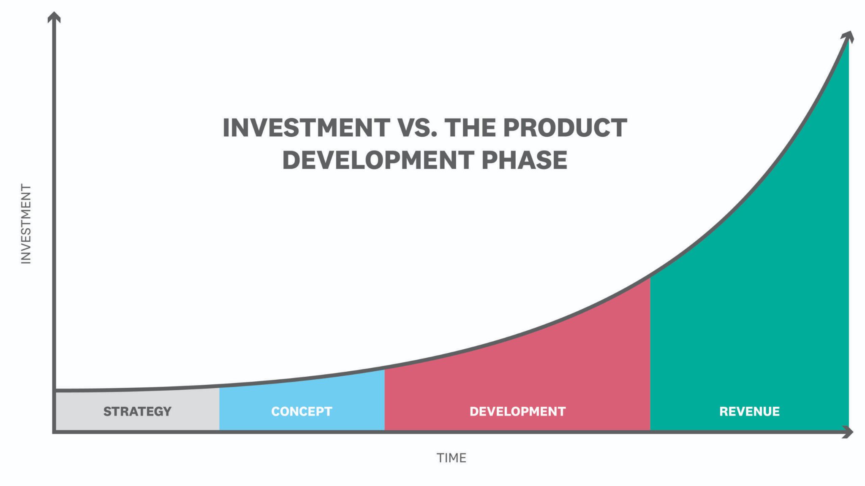
Business
Business Model:
Partnership & Free Trial: Begin by partnering with schools, tutorial classes, and organizations to offer free trials. Gather valuable feedback and insights to refine the platform. In this stage, we are looking for user growth.
Funding: In the early stages, secure funding from angel investors and funding rounds to support initial development and growth.
Subscription Model: As the platform matures, transition to a subscription-based model where schools pay a fee per student to access and utilize the platform for their classes. And some advanced features will only open to subscribers.

Slide 48
Market Expansion
Phase 1: English Language Learning Dominance
Initially, we aim to establish a strong presence in English language learning, capitalizing on our expertise and technology.
As we gain experience and user trust, we will continually enhance our English language learning offering to become a dominant player in this space.
Phase 2: Expansion into Other Languages
Leveraging our successful English language platform, we'll gradually introduce additional languages, broadening our user base and catering to diverse language learning needs.
Each new language expansion will be strategically planned and executed to ensure seamless user experiences.
Phase 3: Diverse Subject Matter
Beyond languages, we envision expanding into a wider array of subjects, such as coding and various school subjects.
Our adaptable platform will facilitate this expansion by accommodating subject-specific content and interactive features.
Customization for Different Subjects
We will offer tailored features to match the unique learning requirements of different subjects.
For instance, coding courses might include interactive coding challenges, while language courses focus on pronunciation exercises.
Scalability and Cost Efficiency
Our flexible software architecture, refined during language learning expansion, allows us to quickly enter new markets.
This scalability is instrumental in keeping development costs low, ensuring cost-effective expansion into diverse subject areas.

Slide 49
Systemwise
API
Massive Users
Database:
Database sharding
Middleware caching
Scalable Architecture:
Apply microservice architecture with load balancing technique.
Server-side:
Use elastic computing services
Buy more servers
Create general frameworks for personalized developing
Provide API to access our service and allow to integrate into developers’ applications

Slide 50
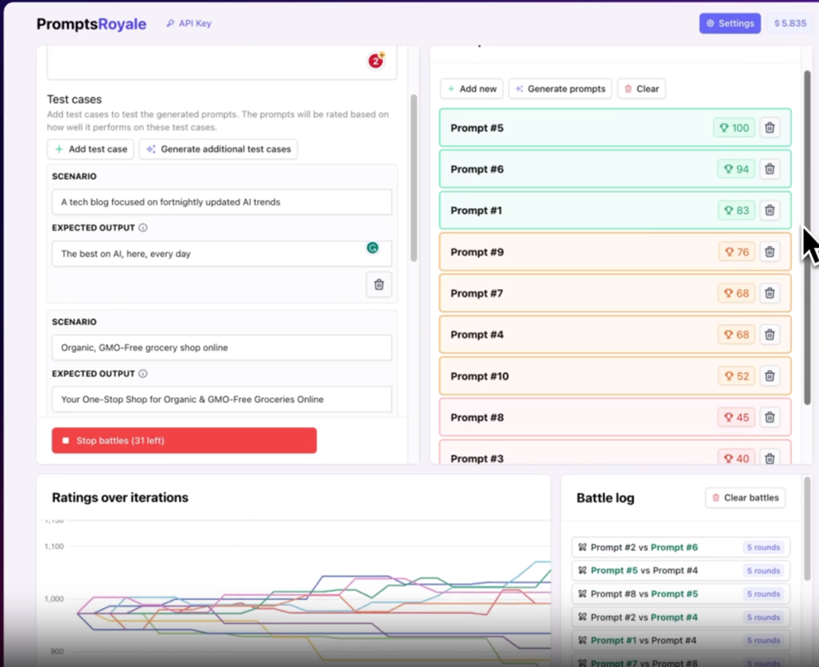
LLM Stability
Prompt Engineering is employed to improve the reliability and performance of the LLM.
Sometimes LLM does not function as anticipated.
To further enhance its effectiveness, we can utilize frameworks such as "promptsroyale" to generate a wide range of test cases, enabling us to evaluate different prompt versions and optimize the system's performance.
https://www.promptsroyale.com/

Slide 51
LLM Stability
Other Methods:
Synchronization
Multi-process + multi-thread asynchronous calling of LLM API to speed up the response.
Distributed deployment of large models
With the increase of request number, we may consider deploy our own LLM on cloud. It is possible to utilize some platform like HuggingFace.
Finetune a LLM like LLaMA to improve the conversation quality and also improve the chatbot’s ability of language teaching.
Off-topic Prevention
Design a “Tree of Thought” (ToT) to detect off-topic Conversation.
Prevent Hallucination:
Knowledge Base can provide LLM some facts.

Slide 52

Data Security and De-identification
The workflow of our system based on a data-centric infrastructure optimized for scalability and security. As users initiate interactions through queries, these inputs undergo structured transformation, aligning them to database norms and making them suitable for further processing.
Subsequent anonymization protocols strip sensitive identifiers, reinforcing the sanctity of user privacy. This sanitized data is then housed in encrypted storage systems that utilize multi-layered security strategies, such as tokenization and access control mechanisms.
Leveraging this repository, machine learning algorithms evolve, trained on aggregated, non-personal data, ensuring no single user's details are discernible. These algorithms, when deployed, offer adaptive responses to user queries, reflecting the balance of dynamic user-centric services with uncompromising data security.

